Slide 1

Design and Simulation of a Digital Data Transmission Error Detection System Using XOR Logic
A Combinational Logic Approach for Detecting Transmission Errors
Subject: Digital Logic Design | Module: 2 — Combinational Circuits
Team Members: [Names] | Roll Numbers: [Roll Nos]
Section / Batch: [Section] | College: [Institution Name]
Binary data flows through a channel — XOR logic catches every flipped bit in real time.
1
2
3
4
5
TRANSMITTER
DIGITAL CHANNEL
RECEIVER
XOR DETECTOR
ERROR STATUS
1 0 1 1
1 0 0 1
0 0 1 0
ERROR DETECTED
Noise / Interference

Slide 2
Why Do We Need Error Detection?
Bits Flip in Transit
Worked Example
Digital data travels as binary 0s and 1s across communication channels. Electrical noise, electromagnetic interference, and signal degradation can silently flip individual bits during transmission.
Transmitted:
1 0 1 1
Received:
1 0 0 1
XOR Outputs:
0 0 1 0
↑
Error at Bit 1
ERROR FLAG = 1
→ ERROR DETECTED
Receiver Cannot Know Automatically
Without dedicated comparison logic, the receiver has no mechanism to distinguish correct data from corrupted data — errors pass through silently.
XOR Is the Solution
XOR compares corresponding transmitted and received bits. Output = 1 when bits differ. A single OR gate aggregates all XOR outputs into one ERROR FLAG.

Slide 3
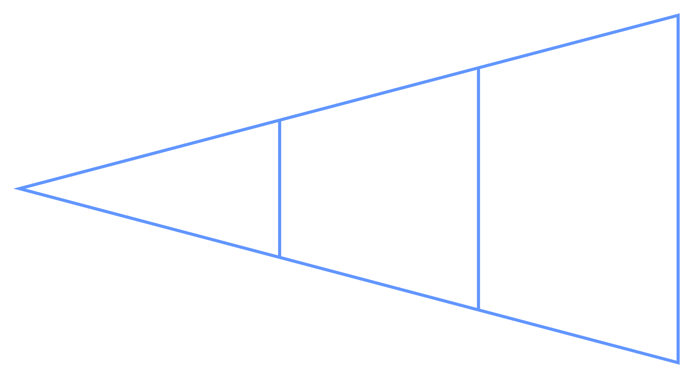

Proposed Error Detection System
The system follows a linear pipeline from data origination to error status output. Two distinct data paths emerge after comparison — one confirming integrity, one raising an alert.
Data Input
Error Detection
Transmission
✓ Path 1 — No Error
⚠ Path 2 — Error Detected
Transmitted bits = Received bits
→ All XOR outputs = 0
→ ERROR FLAG = 0 → NO ERROR
One or more bits changed in channel
→ At least one XOR output = 1
→ ERROR FLAG = 1 → ERROR DETECTED

Slide 4
XOR as the Core Error Detector
XOR Truth Table
T | R | T ⊕ R | Meaning
0 | 0 | 0 | No Error
0 | 1

Slide 5
Module 2 Connection: K-Map & Logic Simplification
K-Maps provide the formal Boolean algebra foundation that derives and verifies the XOR gate implementation from first principles.
K-Map for 1-Bit Comparison
R \ T | T = 0 | T = 1
R = 0 | 0

Slide 6




Module 2 Connection: NAND, MUX & Decoder
The core XOR error detector uses basic XOR gates. NAND, MUX, and decoder represent alternative or extended implementations rooted in Module 2 combinational circuit theory.
NAND-Only Implementation
Multiplexer-Based Selection
Decoder for Control Logic
Universal Gate Property: XOR constructed entirely from NAND gates — critical for VLSI design where fabrication standardizes on NAND cells.
E = ((T NAND R) NAND (T NAND R))
NAND ((T NAND T) NAND (R NAND R))
Data Path Routing: A MUX can select between transmitted and received data paths, or route error signals to appropriate output channels based on a select line.
Enables flexible data steering in extended multi-channel systems where different error responses are needed per channel.
State Classification: A decoder generates unique output lines for each input bit combination, enabling precise classification of error patterns across multiple bits.
Used in control and status logic when the system must distinguish between single-bit, double-bit, and burst errors.
Requires 4 NAND gates per bit. Preferred in silicon implementations for area efficiency.
2-to-4 decoder maps 2-bit error codes to 4 distinct status lines.
MUX select line acts as a mode controller — normal mode vs. diagnostic mode.

Slide 7
Comparator & Error Status Circuit
The XOR gate is functionally a 1-bit magnitude comparator — the foundational building block of all digital comparison circuits covered in Module 2.
1-Bit Comparator Behavior
4-Bit Comparison: Worked Examples
Parameter | Example 1 | Example 2
Transmitted | 1 0 1 1 | 1 0 1 1
Received | 1 0 1 1 | 1 0 0 1
E₃ E₂ E₁ E₀ | 0 0 0 0 | 0 0 1 0
ERROR FLAG
T = R
XOR = 0
Bits match
No error
T ≠ R
XOR = 1
Bits differ
Error flagged
Module 2 Connection: This circuit directly implements the digital comparator — comparing two binary values and producing an equality/inequality output signal.

Slide 8


Circuit Design and Simulation
Logic simulation (Logisim or equivalent) validates the complete 4-bit XOR error detection system with exhaustive test cases covering both correct and erroneous transmission scenarios.
Simulation Components
Simulation Test Cases
Transmitted data input bus: T₃ T₂ T₁ T₀
Test | TX | RX | XOR Out | Flag | Result
1 | 1011 | 1011 | 0000 | 0 | NO ERROR
2 | 1011 | 1001 | 0010 | 1 | ERROR
3 | 1110 | 0110 | 1000 | 1 | ERROR
Received data input bus: R₃ R₂ R₁ R₀
XOR gate array — 4 gates for bit-by-bit comparison
Each test case exercises a unique bit error position. Test 1 confirms true-negative (no false alarms). Tests 2 and 3 confirm true-positive detection at different bit positions across the 4-bit word.
4-input OR gate for ERROR FLAG aggregation
Output indicator: LED or 7-segment display
Simulation validates XOR comparison identifies bit mismatches correctly in all test cases — real-time detection, zero latency memory required.

Slide 9




Extending the System: Adders, Adder-Subtractor & ALU
OPTIONAL EXTENSIONS — BEYOND BASIC XOR DETECTION
The core project delivers XOR-based error detection. The components below represent optional architectural extensions that apply Module 2 combinational concepts to build more capable error-processing systems.
Adders — Error Counting
Adder-Subtractor — Checksums
ALU — Full Processing
A 4-bit binary adder sums the individual error bits:
Count = E₃ + E₂ + E₁ + E₀
Reports the total number of erroneous bits (0–4), enabling severity classification beyond simple detection.
Performs numerical comparison, checksum computation, or data offset processing in advanced error-handling pipelines.
Mode bit switches between addition and subtraction for flexible data verification.
Combines comparison, arithmetic, and logic operations into a unified unit for comprehensive data analysis and error response generation.
Represents the complete integration of all Module 2 combinational concepts.
XOR Detection
Optional Adder
Error Bits
Control Output

Slide 10


Results and Conclusion
Verification Results
Key Conclusions
Transmitted | Received | Error Bits | Result
1011 | 1011 | 0000 | No Error
1011 | 1001 | 0010 | Error
1110 | 0110 | 1000 | Error
0101 | 0101 | 0000 | No Error
XOR — Simple & Efficient
Combinational = Real-Time
Provides bit-mismatch detection with minimal hardware — 4 XOR gates + 1 OR gate for a 4-bit system.
No clock, no memory required. Detection occurs instantaneously as inputs propagate through gates.
Applications
K-Maps Validate Design
Module 2 Fully Applied
Digital communication systems and serial data transmission
Boolean minimization confirms XOR as the optimal implementation — minimal gate count, minimal delay.
NAND, MUX, decoder, comparator, adder, and ALU concepts each contribute to design alternatives and system extensions.
Computer networks and inter-system data buses
Memory systems and data integrity checking
Embedded systems and IoT edge devices
Thank You
Real-time error detection in control systems
Project demonstrates XOR-based combinational error detection — simple logic, real-world impact.
Questions welcome for viva examination.

